Slide 1
Intro to supervised Machine Learning!

Slide 2


Slide 3
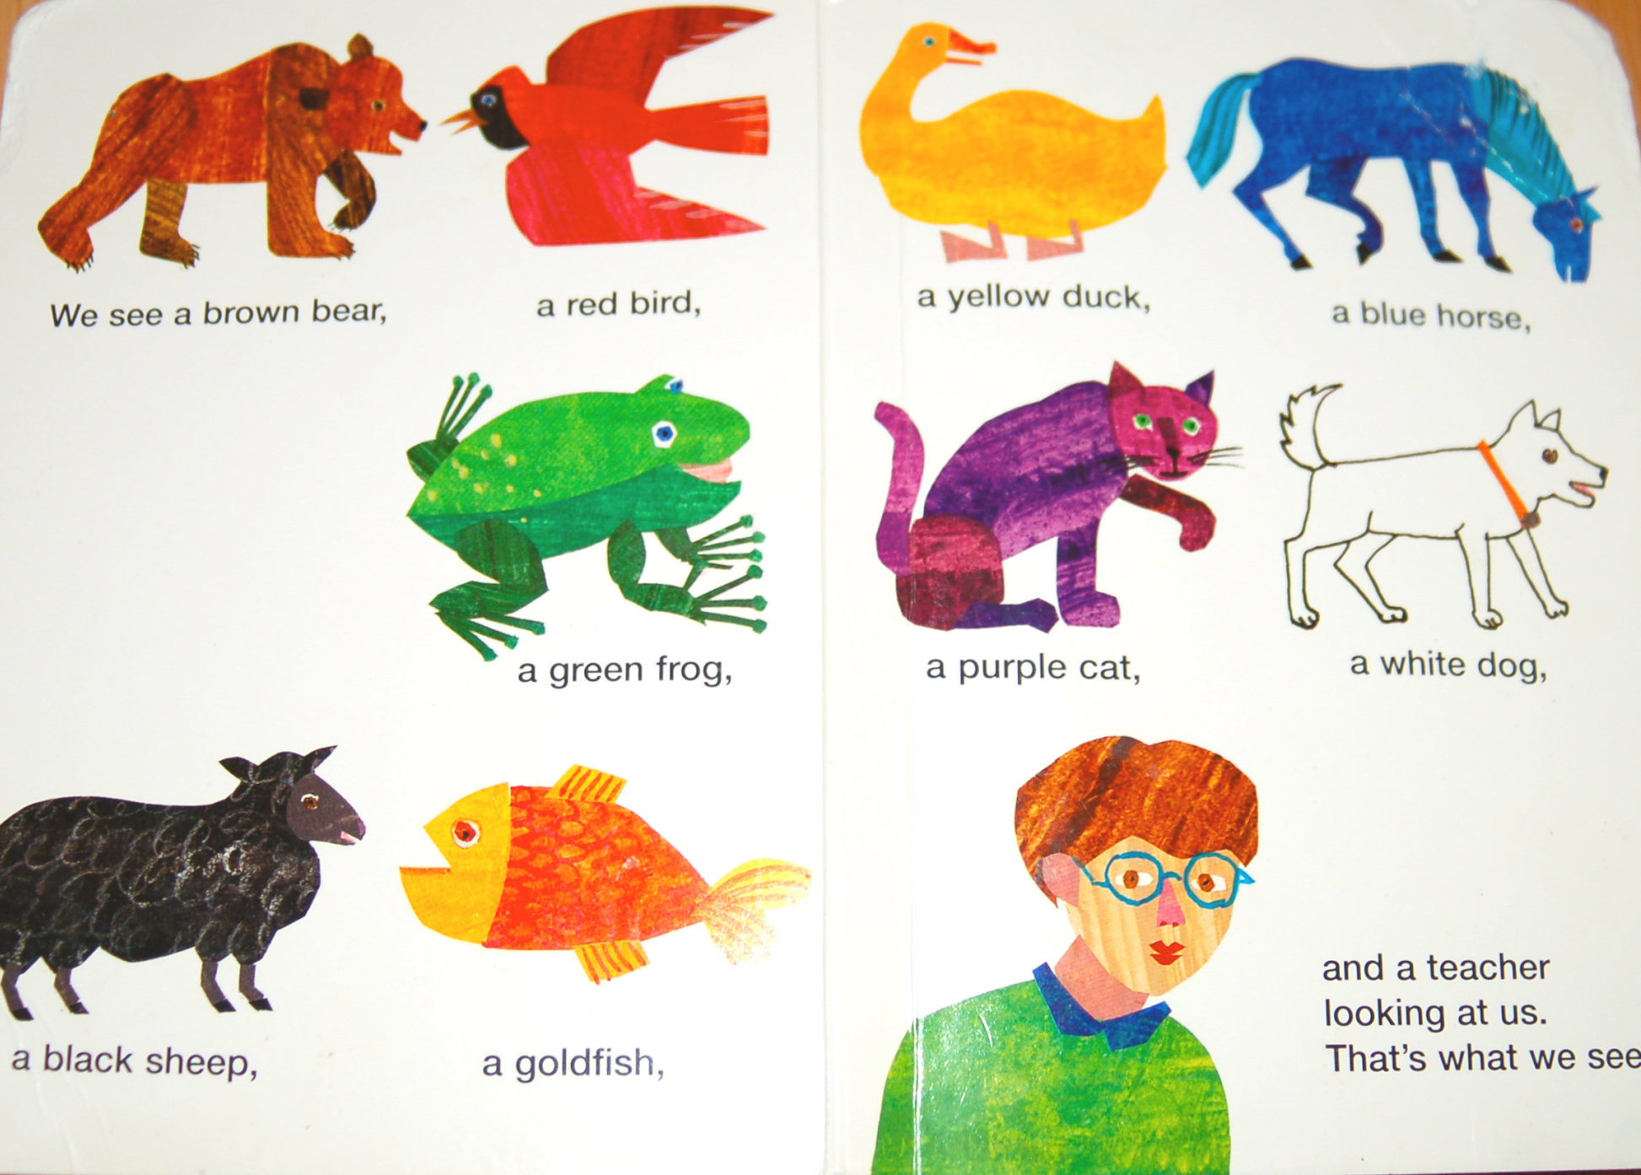

Slide 5
Classification & Regression

Slide 6
Can you name some examples of classification?

Slide 7
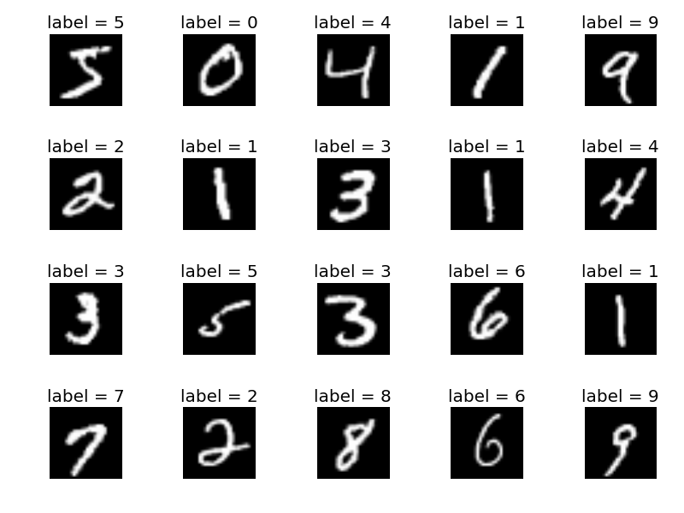
Examples of classification in technology: handwriting detection

Slide 8


Examples of classification in technology: spam filtering

Slide 9

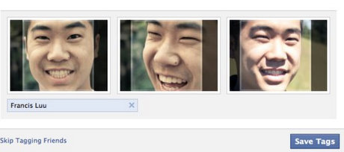
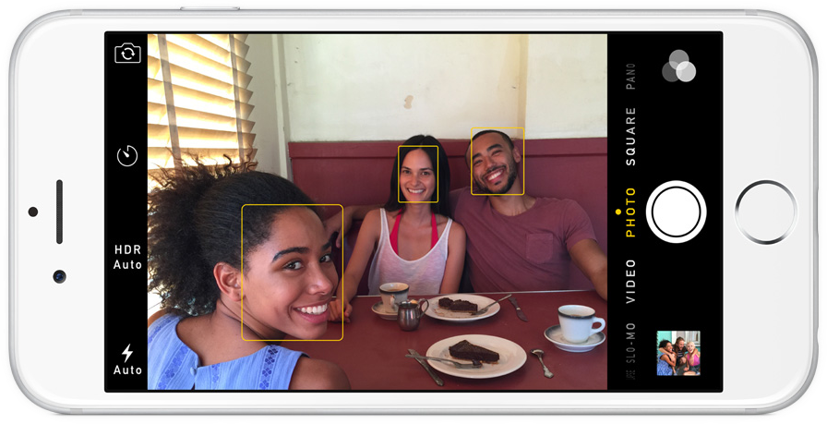
Examples of classification in technology: face detection

Slide 10
Your turn...
Go to https://teachablemachine.withgoogle.com/ (it should be bookmarked)
In partners follow the tutorial
Answer the questions on your activity sheet

